Slide 1
Topic covered:
1. Project size estimation metrics
2. Project estimation techniques
3. Empirical estimation techniques
4.COCOMO-A Heuristic estimation techniques
5. Staffing level estimation
6. team structures
7. staffing

Slide 2
Project size estimation metrics
Project size estimation is the most fundamental parameter. If this is estimated accurately then all other parameters like effort, duration, cost, etc can be determined easily.
There are two techniques that are used to estimate project size are:
1. Line of code
2. Function point

Slide 3
Lines of code or LOC is the most popular and used metrics to estimate size. LOC determination is simple as well. LOC measures the project size in terms of number of lines of statements or instructions written in the source code. In this count, comments and headers are ignored.
Advantages of LOC:
Estimating LOC by analyzing the problem specification is difficult. Estimation of accurate LOC is only possible once the complete code has been developed. As project planning needs to be done before the development work begins so this metrics is of little use for project managers.
Two different source files having same number of lines may not require same effort. The file having complex logic would require more effort than one with simple logic. Based on LOC proper estimation may not be possible.
LOC is the numerical measurement of problem size. This metrics will vary to a large extent from programmer to programmer. An experienced professional may write same logic in less number of lines than a novice programmer.

Slide 4
Function point metrics overcomes many of the shortcomings of LOC.
Function point metrics proposes that size of the software project is directly dependent on various functionalities it supports. More the features supported the more would be the size.
This technique helps determine size of the project directly from the problem specification so is really helpful to project managers during project planning while determining size.

Slide 5
Project estimation technique
Software Project parameters can be estimated using:
Empirical estimation techniques
Heuristic estimation techniques
Analytical estimation techniques

Slide 6
Empirical estimation techniques
Empirical estimation techniques is done on the basis of educated guess of the project parameters.
This technique becomes more helpful of the estimator has already had experience doing similar project in past.
Therefore making suitable educated guess, having prior experience and common sense is good element for this technique.
Popularly used empircal project estimation techniques are:
Expert judgement technique
Delphi estimation techniques

Slide 7
Heuristic estimation techniques works on assumption that the relationships among various project parameters can be represented in the form suitable mathematical expressions.
Once the basic parameters are known, the other parameters can be determined by substituting value of basic parameter in mathematical expression.
It can be widely divided into two classes
1. Single variable model
2. Multivariable model
Popularly used heuristic estimation techniques are:
COCOMO

Slide 8
COCOMO-A Heuristic estimation techniques
COCOMO model was proposed by Boehm in 1981. COCOMO is a heuristic cost estimation technique.
Full form of COCOMO is COnstructive COst estimation Model.
According to Boehm, software development project can be classified into any one of the following based on development complexity:
1. Organic
2. Semidetached
3. Embedded

Slide 9
Organic
According to Boehm, a software development project can be considered as organic type if it deals with:
Team members have experience in developing similar types of projects.
Size of the development team is reasonably small.
Developing well understood application program.

Slide 10
Semidetached
According to Boehm, a software development project can be considered as semidetached type if it deals with:
Development team has mixture of experienced and inexperienced staff.
Team members may have some experience on related system but may not have enough idea on certain aspects of software product to be developed.

Slide 11
Embedded
According to Boehm, a software development project can be considered as embedded type if it deals with:
Software that is developed is strongly coupled to complex hardware or
If stringent regulations on the operational procedures exists.

Slide 12
According to Boehm’s idea, software cost estimation should be done through three stages:
1. Basic COCOMO
2. Intermediate COCOMO
3. Complete COCOMO

Slide 13
BASIC COCOMO
Boehm after studying historical data collected from lots of real time project derived an expression.
The expression derived by Boehm is represented as,
Effort = a₁ * (KLOC)^{a2} PM
Time_{dev} = b₁ * (Effort)^{b2} Months
Here,
KLOC – Estimated size of software product expressed in terms of Kilo Lines Of Code
Time_{dev} – Estimated time in months required to develop the software product
Effort – It represents the total effort required in terms of PM (Person Months)to develop the software.
a_{1,} a2, b₁,b2 are constants for each category of software products.

Slide 14
Effort Estimation
Estimated effort required for different types of software products can be calculated based on below basic cocomo model formula derived by Boehm,
Effort for Organic type project = 2.4*(KLOC)^{1.05} PM
Effort for Semidetached type project = 3.0*(KLOC)^{1.12} PM
Effort for Embedded type project = 3.6*(KLOC)^{1.20} PM

Slide 15
Time Estimation
Development time required for different types of software products can be calculated based on below basic COCOMO model formula derived by Boehm
Time for Organic type project development = 2.5*(KLOC)^{0.38} Months
Time for Semidetached type project development = 2.5*(KLOC)^{0.35} Months
Time for Embedded type project development = 2.5*(KLOC)^{0.32} Months

Slide 16
Intermediate COCOMO
This model refines the above estimate using 15 multipliers that are based on different software development attributes. Complete COCOMO: This model calculates the development time and effort taken as the total of the estimates of all the individual subsystems.
Effort (E) = a*(KLOC)^{b} *EAF MM
Scheduled Time (D) = c*(E)^{d} Months(M) Where,
E = Total effort required for the project in Man-Months (MM).
D = Total time required for project development in Months (M).
KLOC = The size of the code for the project in Kilo lines of code.
a, b, c, d = The constant parameters for the software project.

Slide 17
Complete COCOMO
This model calculates the development time and effort taken as the total of the estimates of all the individual subsystems.

Slide 18
Advantage and disadvantage of COCOMO Model
# Advantage:
a) Easy to estimate the total cost of the project.
b) Easy to implement with various factors.
c) Provide ideas about historical projects.
# Disadvantage:
a) It ignores requirements, customer skills, and hardware issues.
b) It limits the accuracy of the software costs.
c) It mostly depends on time factors.

Slide 19
Staffing level estimation
It is necessary to determine the staffing requirement for the project. Putnam first studied the problem of what should be a proper staffing pattern for software projects. He extended the work of Norden In order to appreciate the staffing pattern of software projects, Norden’s and Putnam’s results must be understood. Staffing level estimation It is necessary to determine the staffing requirement for the project. Putnam first studied the problem of what should be a proper staffing pattern for software projects. He extended the work of Norden.

Slide 20
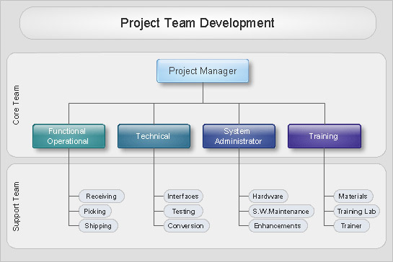
team structures

Slide 21
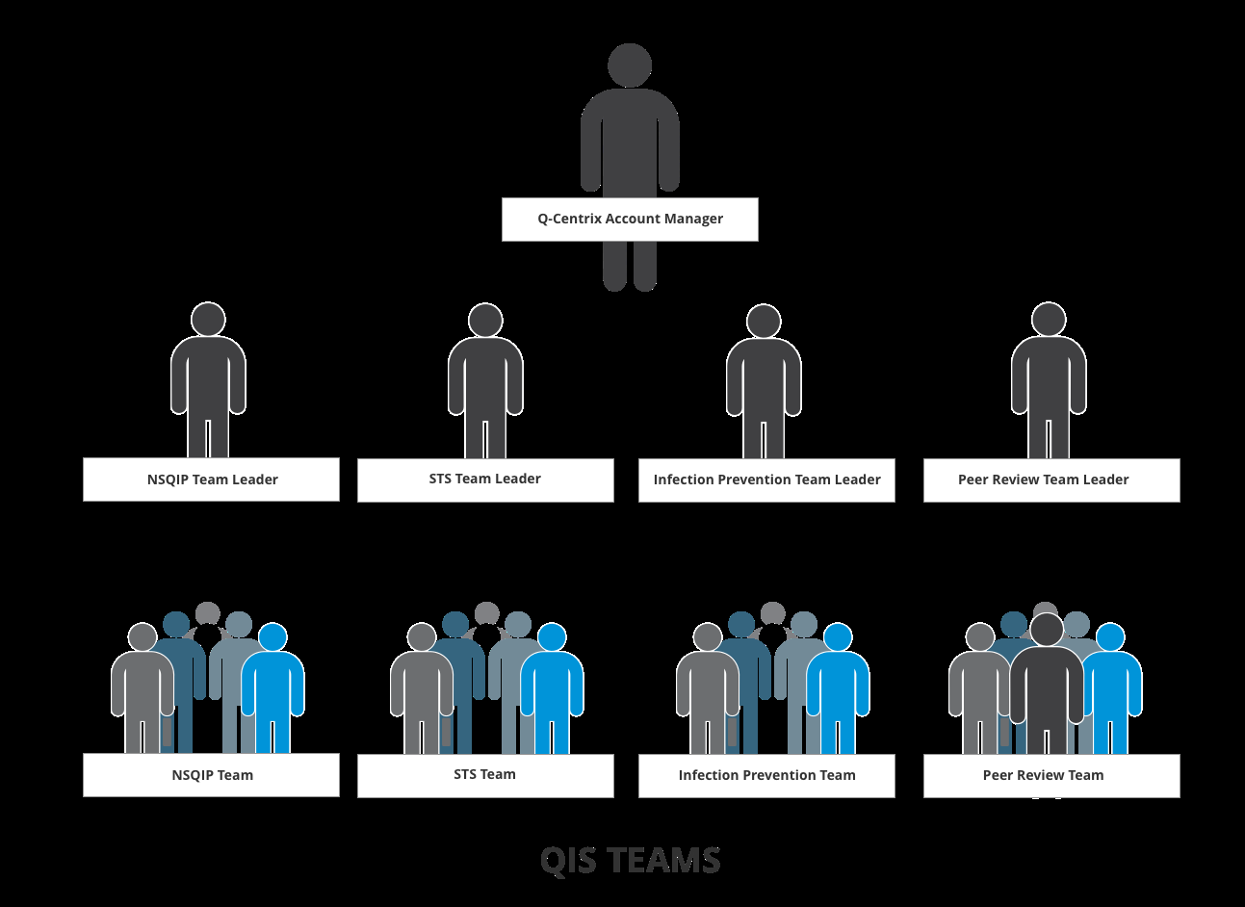
Team Distribution

Slide 22
staffing
Staffing is the managerial function of filling and keeping filled position in the organization structure. This is achieved by first requirement of workspace followed by recruitment , selection, placement, promotion, appraisal and development of personnel to fill the roles designed into the organization.

Slide 23
Component of staffing
Strategic Human Resource Planning
Recruitment
Selection

Slide 24
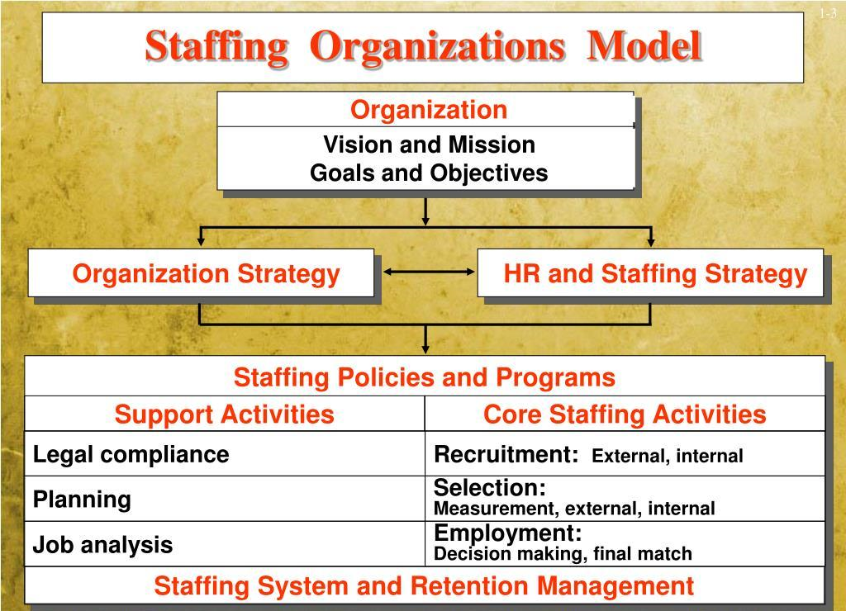

Slide 25
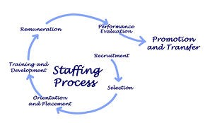
Staffing Process

Slide 26
Nature of staffing
* Staffing is an important managerial function.
Staffing is a pervasive activity.
Staffing is a continous activity
The basis of staffing function is efficient management of personnel.
Staffing helps in placing right men at the right job.
* Staffing is performed by all managers.

Slide 27
IMPORTANCE OF STAFFING
# Optimum use of resource.
# Enhances corporate Image.
# Job Satisfaction.

Slide 28
Thank you

